Slide 1
Attainment Data for Students in the MMFG
September 2012 Update
Revision 2.0
R. Quen Lee, BSc, OD, MBA
Baz van Cranenburgh

Slide 2
Contents
Combined Results from All Schools
Summary of School Results
Analysis of School Data
Feltham Year 1 (2010-2011 data)
Feltham Year 2 (2011-2012 data)
Victoria
Forge Lane
Conclusions
Appendix
Average APS Scores (MMFG vs. Control vs. School)
Sample of Individual Student Scores compared to controls
Key Insights Revealed:
Overall, the MMFG program is having a positive impact on student attainment. On average, the initial data indicates that MMFG students advance their APS scores faster than the National Curriculum benchmark.
The rate of progress in attainment is quite variable for each individual student on a term by term basis. Because of the small number of MMFG students at each school, there is also much variability in the comparison of results from school to school.
This analysis gains more and more robustness, as more data is collected from the students involved and added to the model. As the study grows, the impact of any missing data elements will be minimized, and more certain conclusions about the impact of the MMFG program can be established.

Slide 3
Combined Results from All Schools
Combined Average
Delta APS per Term
On average, MMFG students appear to advance their APS scores faster than the National Curriculum benchmark (1.10 per term for MMFG, versus 1.0 per term for NC)
MMFG students advanced their APS scores slower in Science and English compared to other subject areas.
Note: Delta APS refers to the rate of change in APS from one term to the next

Slide 4
Summary of School Results:
The results of the data varies between the schools.
Most cohorts studied did better than the benchmarks. Only Feltham Yr2 had trouble.
School | Delta APS of MMFG compared to NC benchmark of 1.0 | Delta APS of MMFG compared to School Average | Delta APS of MMFG compared to Control Group | Delta APS of MMFG during the program, compared to before and after | Absolute APS scores of MMFG compared to School Avg and Control Groups (see Appendix I)
Feltham Yr1 (6 students) | Better | Better | Better | Lower Delta APS during the MMFG program compared to before and after. (caveat – small sample, data gaps) | Lower than the school average, but similar to Control Group.
Feltham Yr2 (6 students) | Slightly Worse | Worse | Worse | Higher Delta APS during the program compared to before. (caveat – small sample, data gaps) | Similar to the school average, but higher than the control group.
Victoria (11 students) | Better | n/a | n/a | Higher Delta APS during the MMFG program compared to before and after | n/a
Forge Lane (9 students) | Better | n/a | n/a | Higher Delta APS during and after the program, compared to before. | n/a
Note: Delta APS refers to the rate of change in APS from one term to the next

Slide 5
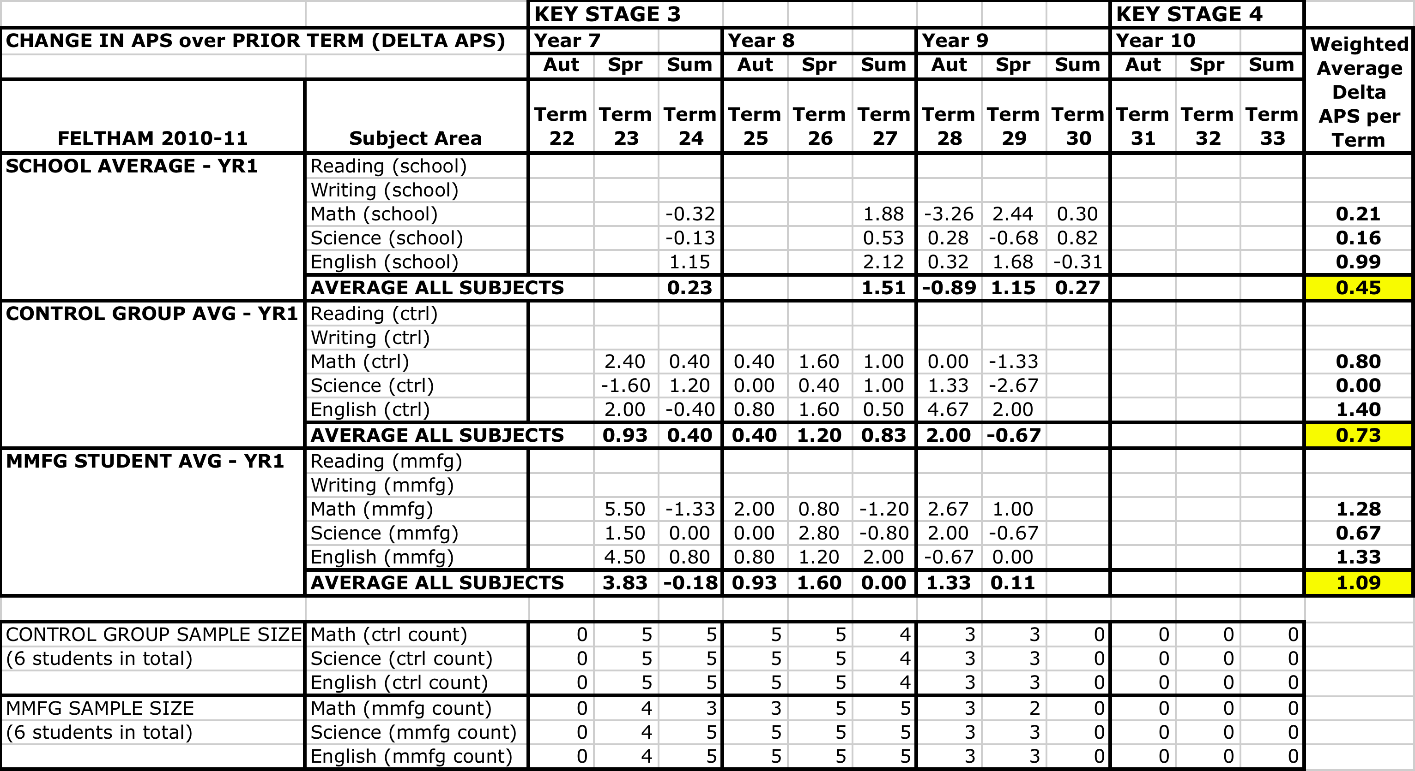
Feltham 2010-11
Average Delta APS per Term
MMFG Group vs. Control Groups
On average, the MMFG students appear to advance their APS scores faster in comparison to the control group and the total school average.

Slide 6
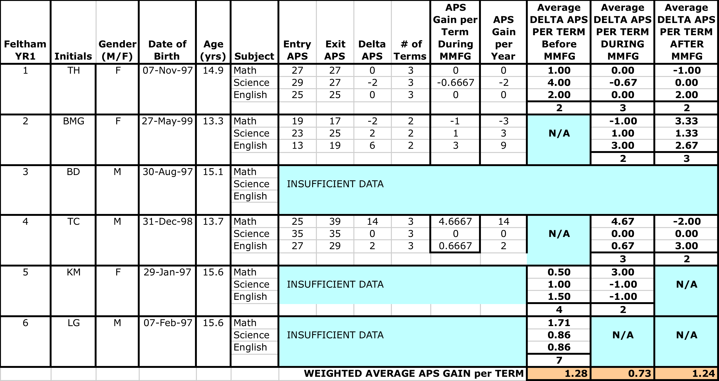
Feltham 2010-11
Delta APS
MMFG Students Only
Although it may appear that this group did not perform well during the MMFG program, the data from the Feltham Yr1 cohort has several missing elements and might be considered not sufficient enough to draw conclusions.

Slide 7
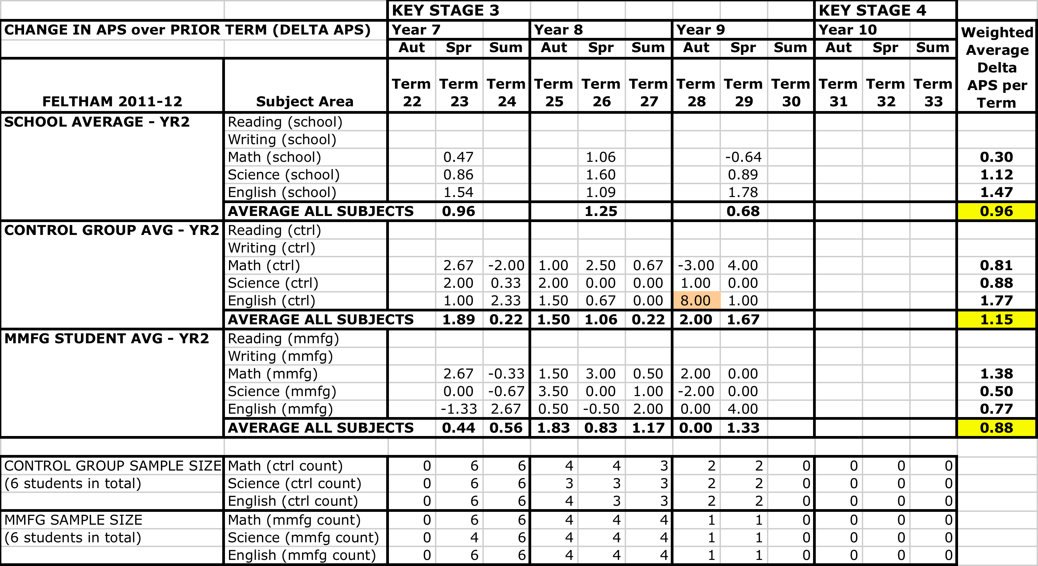
Feltham 2011-12
Average Delta APS per Term
MMFG Group vs. Control Groups
On average, the MMFG students of the Feltham Yr2 cohort appear to advance their APS scores slower in comparison to both the total school average and the control group.

Slide 8
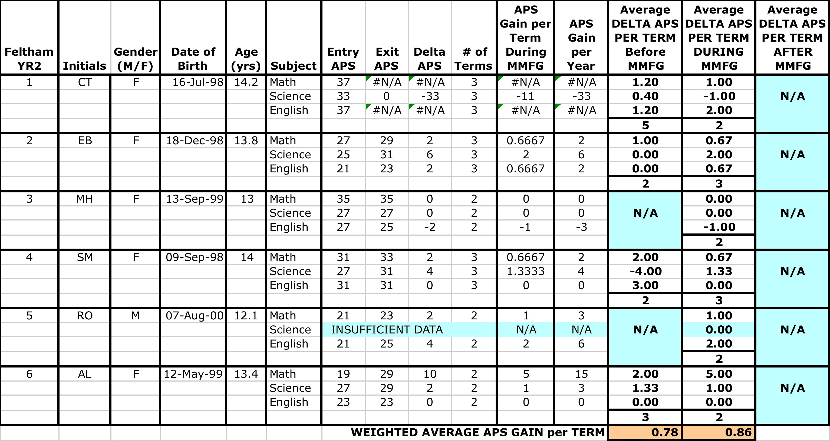
Feltham 2011-12
Delta APS
MMFG Students Only
MMFG students appear to advance at a faster rate during the program, compared to before the program.

Slide 9
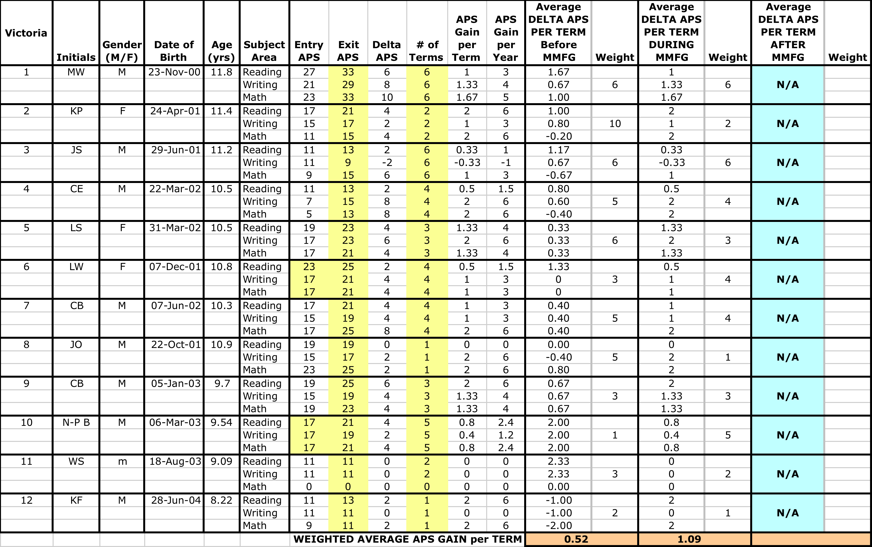
Victoria
Change in APS over Prior Term
MMFG Students
Victoria MMFG students advanced at a faster rate during the terms when they were participating in the program.

Slide 10
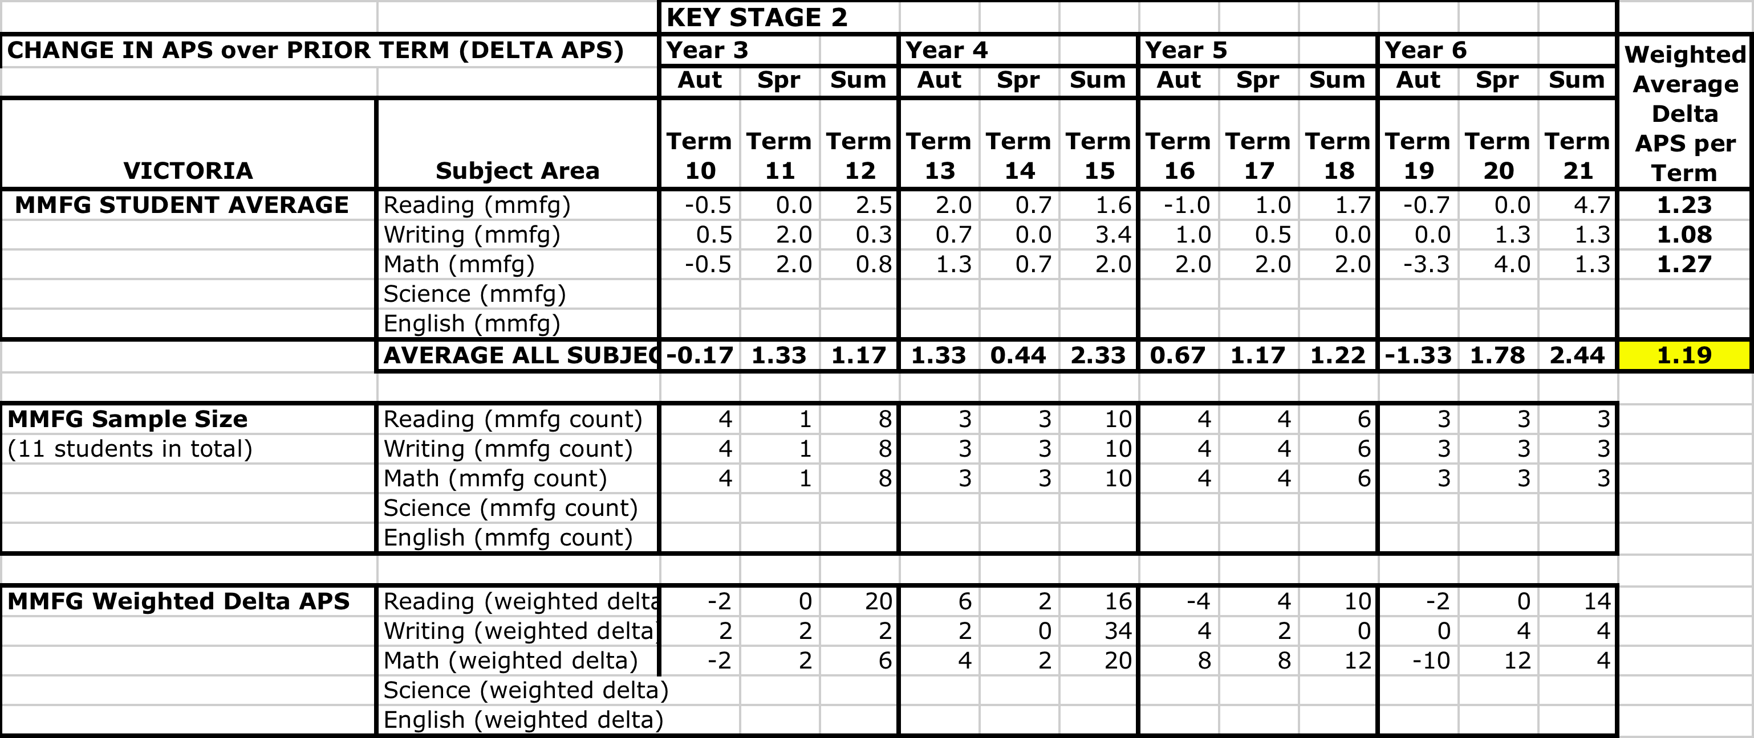
Victoria
Average Delta APS per Term
Victoria MMFG Students
The average Delta APS per term for MMFG students from Victoria is higher than the National Curriculum benchmark.
No control group or other comparisons data was provided from this school.

Slide 11
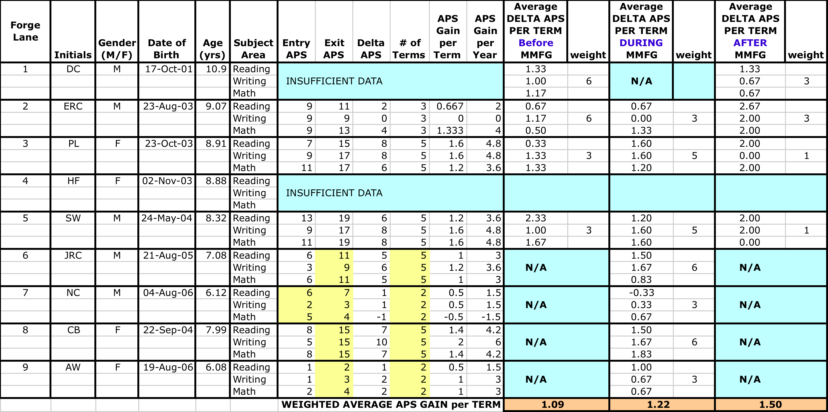
Forge Lane
Change in APS over Prior Term
MMFG Students
Forge Lane MMFG students experienced faster advancement during and after the MMFG program.

Slide 12
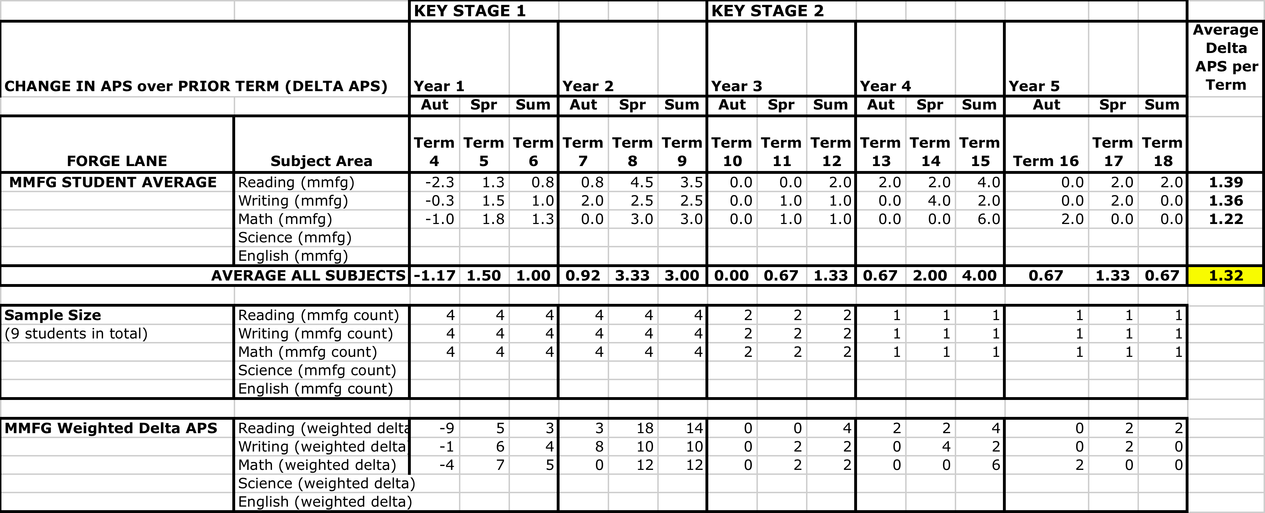
Forge Lane
Average Delta APS per Term
Forge Lane MMFG Students
The average Delta APS per term for MMFG students from Forge Lane is greater than the NC benchmark of 1.0.
No control group or other comparisons data was provided from this school.

Slide 13
Conclusions
Overall, the MMFG program is having a positive impact on student attainment. On average, initial data indicates that MMFG students advance their APS scores faster than then National Curriculum benchmark.
The rate of progress in attainment is quite variable for each individual student on a term by term basis. Because of the small number of MMFG students at each school, there is also much variability in the comparison of results from school to school.
This analysis gains more and more robustness, as more data is collected from the students involved and added to the model. As the study grows, the impact of missing data elements will be minimized, and more certain conclusions about the impact of the MMFG program can be established.

Slide 14
Contact: Baz van Cranenburgh
So What Research Ltd
23 Kew Road
Richmond, Surrey TW9 2NQ
United Kingdom
Tel: + 44 203 274 1099
Fax: + 44 274 1082
Cell: + 44 78 50 46 48 39
E-mail: baz@sowhatresearch.com
Web: www.sowhatresearch.com

Slide 15
Appendix I: MMFG vs. CONTROL vs. SCHOOL Average APS Scores

Slide 16
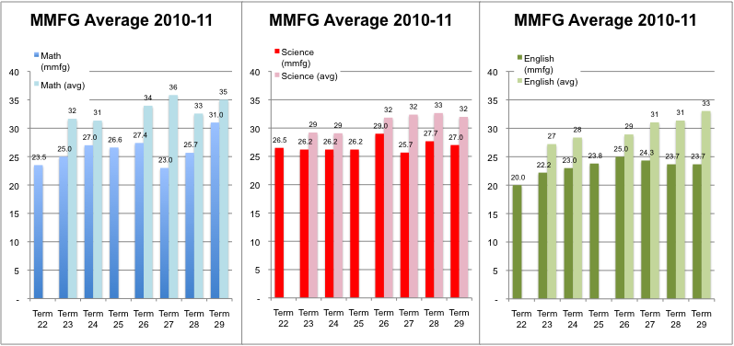
Feltham 2010-11
MMFG Average
versus School Average
On average, the MMFG students had lower APS scores than the school average.
CAVEAT: the “average” term score for MMFG, in certain periods, might only be derived from one or two students.

Slide 17
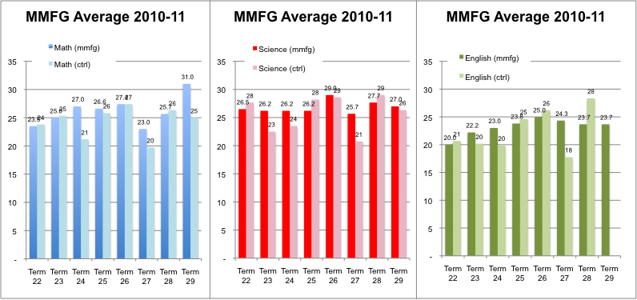
Feltham 2010-11
MMFG Average
versus Control Group Average
On average, the MMFG students had similar APS scores compared to the Control Group.
CAVEAT: both MMFG group and control group involved very small samples.

Slide 18
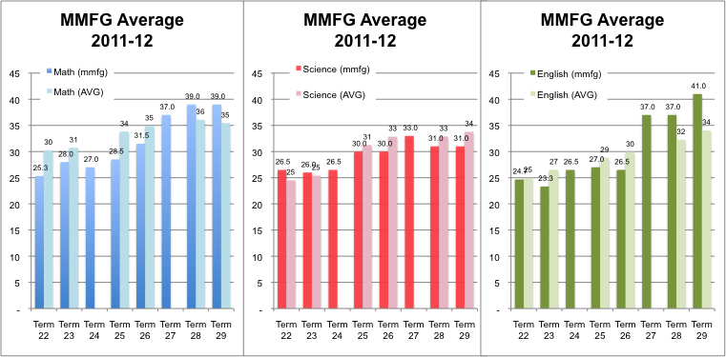
Feltham 2011-12
MMFG Average
versus School Average
On average, the MMFG students had similar APS scores compared to the school average.
CAVEAT: the “average” term score for MMFG, in certain periods, might only be derived from one or two students.

Slide 19
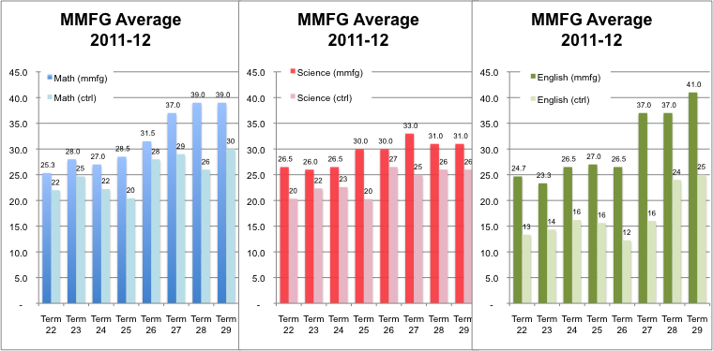
Feltham 2011-12
MMFG Average
versus Control Group Average
On average, the MMFG students had higher APS scores than the control group.
CAVEAT: both MMFG group and control group involved very small samples.

Slide 20
Appendix II: Individual Student Attainment

Slide 21
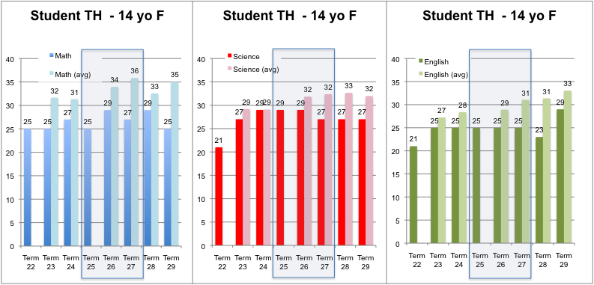
Feltham 2010-11
Student 1 vs. School Average

Slide 22
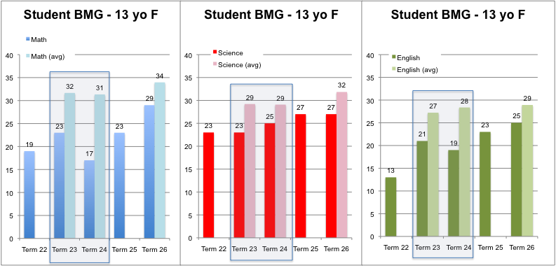
Feltham 2010-11
Student 2 vs. School Average

Slide 23
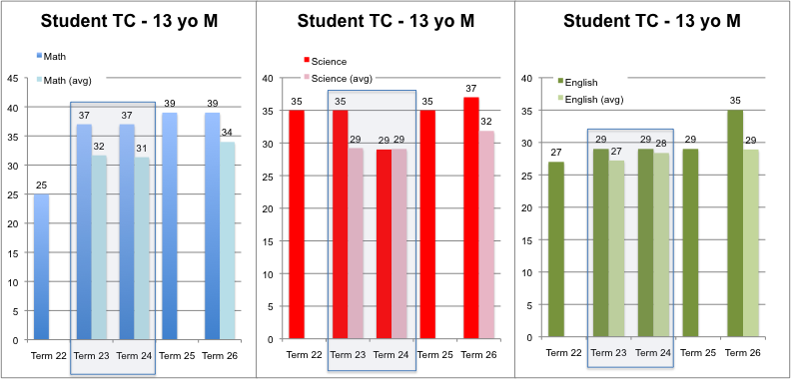
Feltham 2010-11
Student 4 vs. School Average

Slide 24
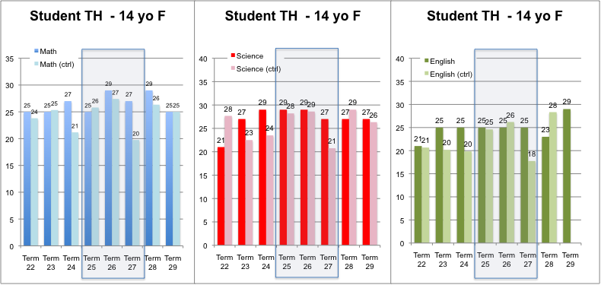
Feltham 2010-11
Student 1 vs. Control Group

Slide 25
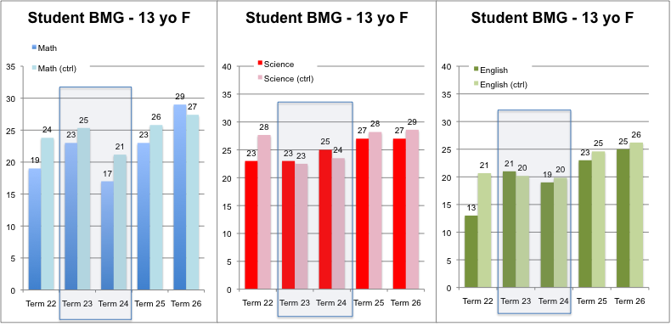
Feltham 2010-11
Student 2 vs. Control Group

Slide 26
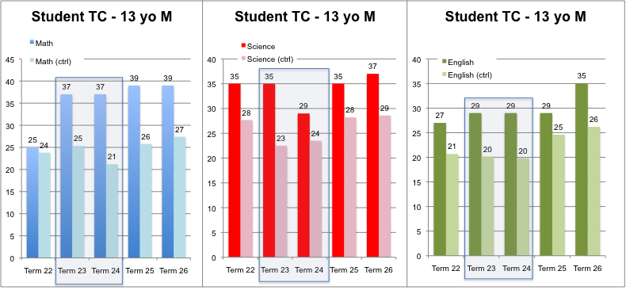
Feltham 2010-11
Student 4 vs. Control Group

Slide 27
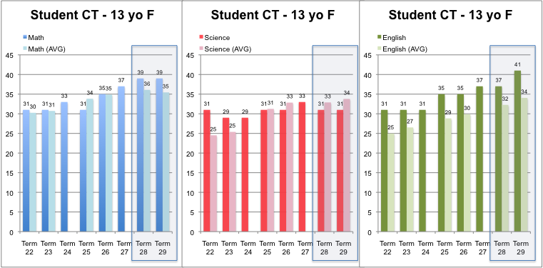
Feltham 2011-12
Student 1 vs. School Average

Slide 28
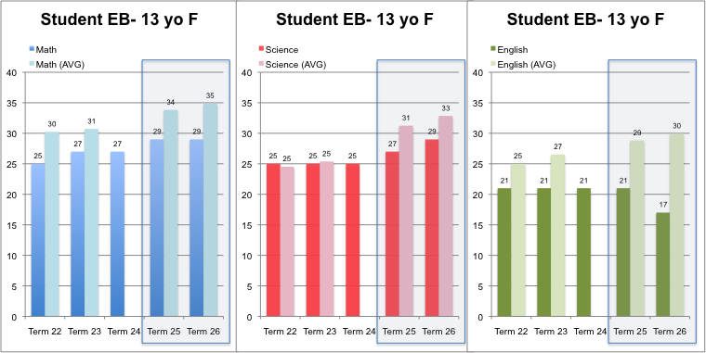
Feltham 2011-12
Student 2 vs. School Average

Slide 29
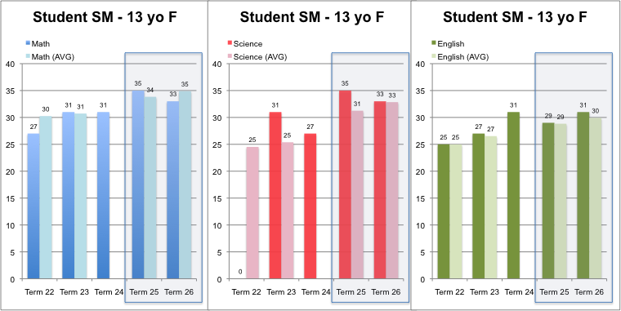
Feltham 2011-12
Student 4 vs. School Average

Slide 30
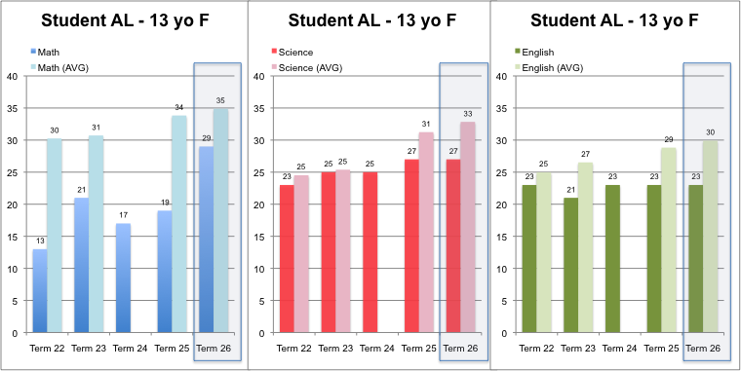
Feltham 2011-12
Student 6 vs. School Average

Slide 31
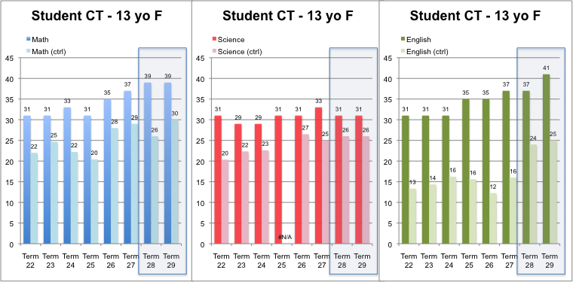
Feltham 2011-12
Student 1 vs. Control Group

Slide 32
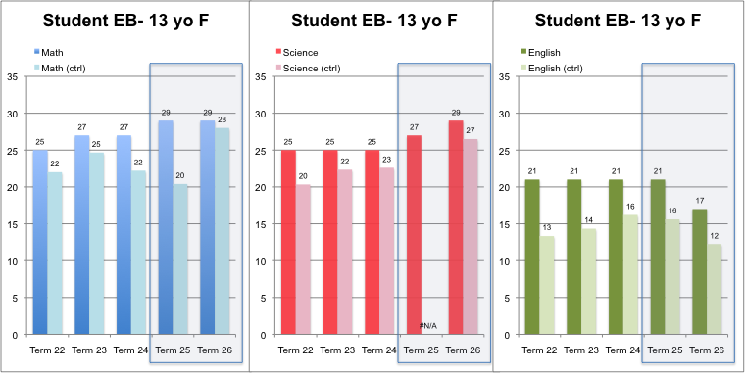
Feltham 2011-12
Student 2 vs. Control Group

Slide 33
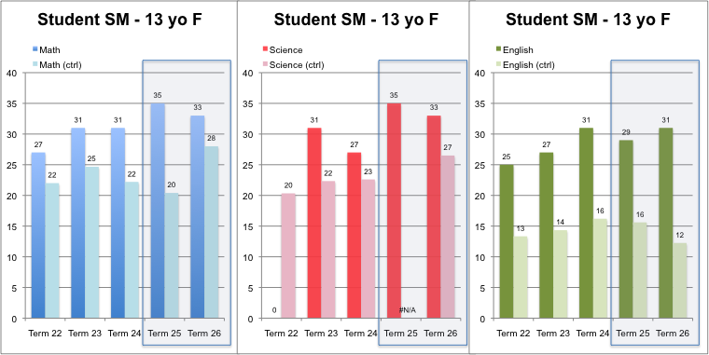
Feltham 2011-12
Student 4 vs. Control Group

Slide 34
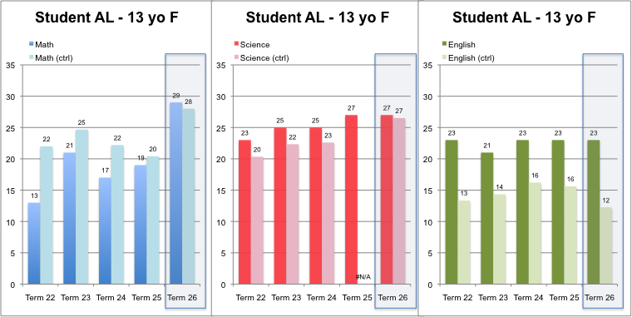
Feltham 2011-12
Student 6 vs. Control Group

